Slide 1
Flow Sensors
Nooruddin : 6218000081
Rahul : 6217000181
Jannatun Ferdous:6218000014

Slide 2
FLOW SENSOR
Basics of Flow Dynamics
Pressure Gradient Technique
Thermal Transport Sensors
Hot-Wire Anemometers
Three-Part Thermo anemometer
Two-Part Thermo anemometer
Micro flow Thermal Transport Sensors

Slide 3
Basics of Flow Dynamics
Flow is defined as the quantity of fluids (gas, liquid, vapour ) that passes a point per unit time.
It can be presented by a simple equation
Flow = Quantity/Time.
It is the rate of change of a quantity. It is either volumetric or mass flow rate

Slide 4
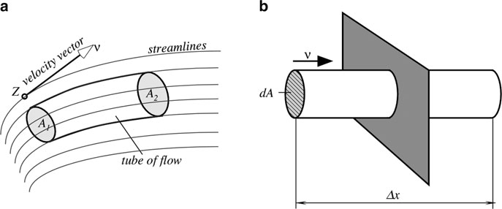
Basics of Flow Dynamics
Flow = V/Δt = ∫ (Δx/­­­­­Δt) * dA
Where,
v is the velocity of moving medium which must be integrated over area A.
while Δx is the displacement of volume V.
Fig. 1: Tube of flow and flow of a medium through a plane

Slide 5
Basics of Flow Dynamics
When dealing with virtually incompressible fluids (water, oil, etc.), either volume or mass can be used. A relationship between mass and volume for an incompressible material is through density ρ
M = ρV

Slide 6
Pressure Gradient Technique
The pressure gradient technique (of flow measurement) essentially requires an introduction to a flow resistance.
Measuring the pressure gradient across a known resistor allows to calculate a flow rate.
The restricting elements that cause flow resistances are orifices, porous plugs, and Venturi tubes.

Slide 7
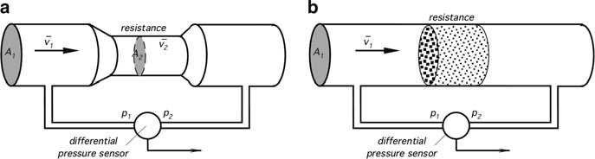

Pressure Gradient Technique
A differential pressure sensor is positioned across the resistor.
When a moving mass enters the higher resistance area, its velocity increases in proportion to the resistance increase:
The Bernoulli equation defines differential pressure as
Fig. 2 : Two types of flow resistors: a narrow channel (a) and a porous plug (b)

Slide 8
Thermal Transport Sensors
The sensors that detect the rate of heat dissipation in flowing media are called thermal transport flow meters or thermo anemometers
Advantages of these sensors are the absence of moving components and an ability to measure very low flow rates.
Some of thermal transport flow sensors:
Hot-Wire Anemometers
Three-Part Thermoanemometer
Two-Part Thermoanemometer
Microflow Thermal Transport Sensors

Slide 9
Hot-Wire Anemometers
The oldest and best-known thermal transport flow sensors are the hot-wire and later developed hot-film anemometers.
It is a single-part sensor
key element of this sensor is a heated wire having typical dimensions 0.00015–0.0002 in. (0.0038–0.005 mm) in diameter
0.040–0.080 in. (1.0–2.0 mm) in length.
The wire resistance typically is between 2 and 3 Ὠ.
The operating principle is based on warming up the wire by electric current to 200–300C, well above the flowing media temperature and then measuring temperature of the wire.

Slide 10
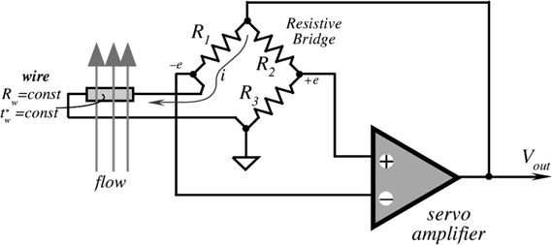
Hot-Wire Anemometers
A servo amplifier keeps the bridge in a balanced state.
Resistors R1–R3 are constant, while Rw represents resistance of the hot wire and is temperature dependent.
Drop in the wire temperature tw causes temporary drop in Rw.
A subsequent reduction in the
bridge voltage -e that is
applied to the negative input
of the servo amplifier.
When Vout goes up, current i
through the wire increases,leading
to increase in temperature.
The feedback voltage Vout is the output signal of the circuit and the measure of the mass flow rate.
Fig-3: Hot-wire anemometer

Slide 11
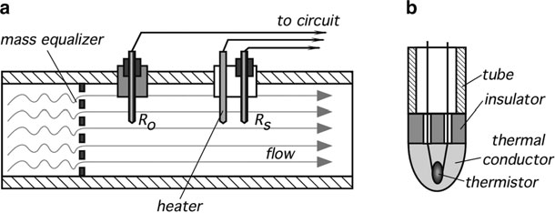
Three-Part Thermo anemometer
This sensor is comprised of three small tubes immersed into a moving medium.
Two tubes contain temperature detectors Ro and Rs
The detectors are thermally coupled to the medium and are thermally isolated from the structural elements and the Pipe where the flow is measured.
In between two detectors, a heating element is positioned.
Both detectors are connected to electrical wires through tiny conductors to minimize thermal loss.
Fig. 4: Three-part thermoanemometer.
Basic two-sensor design (a); cross-sectional view of a temperature sensor (b)

Slide 12
Three-Part Thermo anemometer
Operating Process:
The first temperature detector Ro measures the temperature of the flowing medium.
The elevated temperature is measured by the second temperature detector Rs.
Since the heater is positioned closer to the Rs detector, that detector will register higher temperature.
When the medium flows, heat dissipation increases due to forced convection.
The higher the rate of flow the higher the heat dissipation and the lower temperature will be registered by the Rs detector.

Slide 13

Three-Part Thermo anemometer
Heat loss is measured and converted into the flow rate of medium. An incremental heat change is
where k and c are the thermal conductivity and specific heat of a medium at a given pressure,
r is the density of the medium, l and d are the length and diameter of the second temperature sensor,
ts - surface temperature of the second sensor,
tf - temperature of the first sensor and
n - velocity of the medium

Slide 14
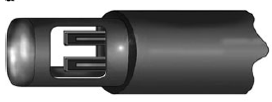
Two-Part Thermo anemometer
Three functions should be accomplished by the sensor: measuring temperature of the flowing media, heating the media, and monitoring the cooling effect caused by the flow.
Figure-5 shows a two-part thermo anemometer where
one part is the media temperature reference sensor S,
while the other part is a combination
of the heating H and temperature
sensing S2 elements that are kept
in an intimate thermal coupling with
each other.
Fig. 5 Two-part thermo anemometer probe

Slide 15
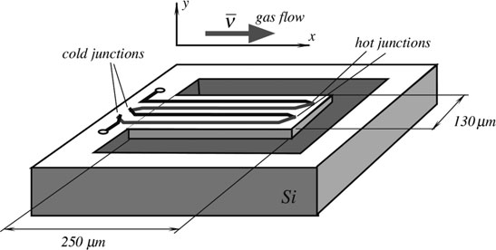
Microflow Thermal Transport Sensors
A cantilever design of a microflow sensor is shown in Fig. 6.
Thickness of the cantilever may be as low as 2 mm. It is fabricated in the form of a sandwich consisting of layers of field oxide, CVD oxide, and nitrate .
The cantilever sensor is heated by an imbedded
resistor with a rate of 26 K/mW
of applied electric power, and
a typical transfer function of the
flow sensor has a negative slope
of about 4 mV(/m/s).
Fig-6 : Micromachined gas flow sensor

Slide 16

Microflow Thermal Transport Sensors
The heat is removed from the sensor by three means: conductance Lb through the cantilever beam, gas flow h(v) and thermal radiation, which is governed by the Stefan–Boltzmann law:
where,
σ is the Stefan–Boltzmann constant,
a is the area along which the beam-to-gas heat transfer occurs,
ϵ is surface emissivity, and
v is the gas velocity.

Slide 17
Coriolis Mass Flow Sensors
Coriolis flowmeters measure flow of mass directly, as opposed to those that measure velocity or volume.
Coriolis flowmeters are virtually unaffected by the fluid pressure, temperature, viscosity, and density.
As a result, Coriolis meters can be used without recalibration and without compensating for parameters specific to a particular type of fluid.
While these meters were used mainly for liquids when they were first introduced, they have become adaptable for the gas applications.

Slide 18
Coriolis Mass Flow Sensors
Coriolis flowmeters are named after Gaspard G. Coriolis (1792–1843), a French civil engineer and physicist.
A Coriolis sensor typically consists of one or twovibrating tubes with an inlet and an outlet.

Slide 19
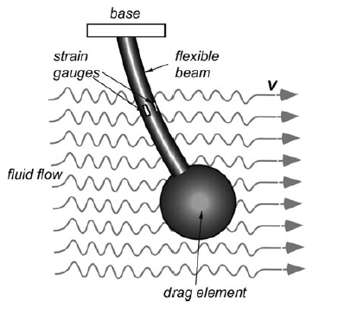

Drag Force Sensors
The Applications of Drag Force Sensors include environmental monitoring, meteorology, hydrology, and maritime studies to measure speeds of air or water flow and turbulence close to surface.
Because when fluid motion is sporadic, multidirectional, and turbulent, a drag force flow sensor may be quite efficient.
In the flowmeter, a solid object known as a drag element or target is exposed to the flow of fluid. The force exerted by the fluid on the drag element is measured and converted to an electrical signal indicative of value for speed of flow.

Slide 20
Drag Force Sensors
An important advantage of the drag sensor is that it can be made to generate a measurement of flow in two dimensions, or even in three dimensions, as well as of flow speed.
To implement feature, the drag element must be symmetrical in the appropriate number of dimensions. These flowmeters have been used by industry, utilities, aerospace, and research laboratories to measure the flow of uni- and bi-directional liquids (including cryogenic), gases, and steam (both saturated and superheated) for nearly half a century.

Slide 21
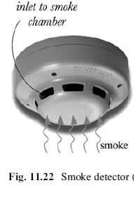
Dust and Smoke Detectors
Smoke and air gas impurity sensors are intended for detecting presence of small airborne particles and have wide range of applications.
Even though these detectors do not monitor air flow, their operation essentially requires movement of gas through the detection chamber of the sensor.
By far the most popular are the smoke detectors. Such a detector is positioned on or near a ceiling.

Slide 22
Breeze Sensor
In some applications, it is desirable just to merely detect a change in the air (or any other gas for that matter) movement, rather than to measure its flow rate quantitatively.
This task can be accomplished by a breeze sensor, which produces an output transient whenever the velocity of the gas flow happens to change.
One example of such a device is a piezoelectric breeze sensor produced by Nippon Ceramic, Japan.

Slide 23
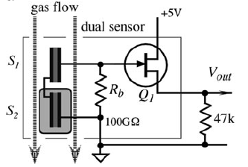
Breeze Sensor
A sensor contains a pair of the piezoelectric (or pyroelectric) elements, where one is exposed to ambient air and the other is protected by the encapsulating resin coating.
Two sensors are required for a differential compensation of variations in ambient temperature.

Slide 24
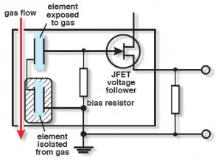
Working of Breeze Sensor
A piezo breeze sensor discloses increases in the velocity of the air or other gas to which it is exposed. The sensor contains two piezoelectric elements in a series-opposed circuit.
One element is exposed to the gas whose velocity is being monitored, the other is isolated from the gas.
When the gas is motionless, or its flow is relatively constant, charged air molecules at the surfaces of the element exposed to the gas are in balance with the free charge carriers and dipoles in the element.

Slide 25
Working of Breeze Sensor
The charge across the element is balanced and both elements generate the same electric charge. Voltage across the bias resistor is approximately zero.
When gas movement increases, however, the charges at the surfaces of the element exposed to the gas are removed from the surface at an increased rate, and the charge across the element is thrown out of balance.
A voltage across the resistor indicates the two elements are no longer in balance.

Slide 26
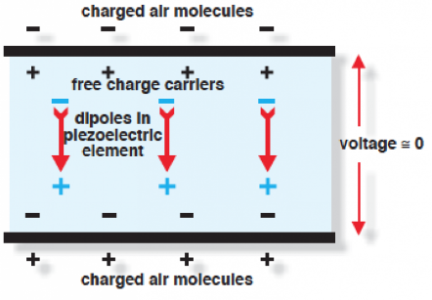
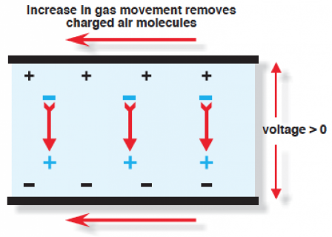
Working of Breeze Sensor

Slide 27
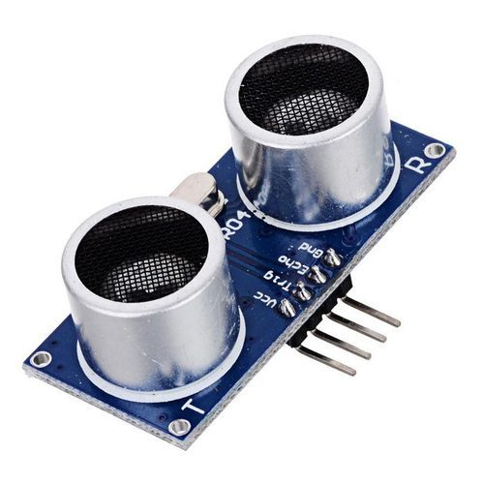
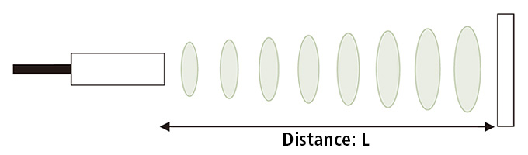
Ultrasonic Sensors
Ultrasonic sensors or Ultrasonic transducers are a type of acoustic sensor divided into three broad categories:
Transmitters
Receivers
Transceivers
As the name indicates, ultrasonic sensors measure distance by using ultrasonic waves.

Slide 28
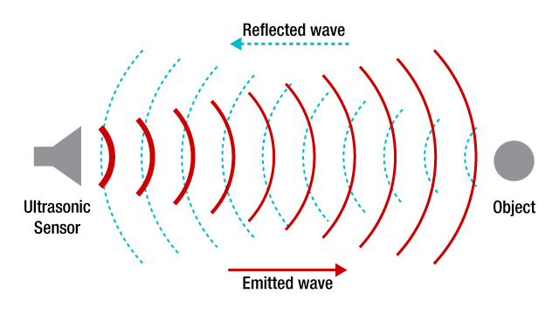
Ultrasonic Sensors
Transmitters convert electrical signals into ultrasound
Receivers convert ultrasound into electrical signals
Transceivers can both transmit and receive ultrasound.
In a similar way to radar and sonar, ultrasonic transducers are used in systems which evaluate targets by interpreting the reflected signals.

Slide 29
Transducers
Ultrasonic transducers convert AC into ultrasound, as well as the reverse. Ultrasonic, typically refers to piezoelectric transducers or capacitive transducers.
Piezoelectric crystals change size and shape when a voltage is applied; AC voltage makes them oscillate at the same frequency and produce ultrasonic sound.
Capacitive transducers use electrostatic fields between a conductive diaphragm and a backing plate.

Slide 30
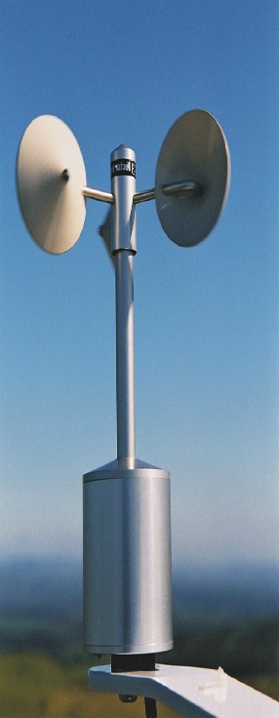
Applications of Ultrasonic Sensors
Ultrasound can be used for measuring wind speed and direction (anemometer).
Tank or channel fluid level
Speed through air or water
Humidifiers
Sonar

Slide 31
Electromagnetic Sensors
The electromagnetic flow sensors are useful for measuring the movement of conductive liquids.
The operating principle is based on the discovery of Faraday and Henry of the electromagnetic induction.
When a conductive media, wire, for instance, or for this particular purpose, flowing conductive liquid crosses the magnetic flux lines
E.M.F. is generated in the conductor.
The value of e.m.f. is proportional to velocity of moving conductor.

Slide 32
References
https://www.americanpiezo.com/blog/piezo-breeze-sensors/
https://www.keyence.com/ss/products/sensor/sensorbasics/ultrasonic/info/

